Slide 1
INFERTILITY

Slide 2
Introduction
Primary infertility The inability to conceive after 1 year of unprotected intercourse for a woman younger than 35, or after 6 months of unprotected intercourse for a woman 35 or older (Speroff & Fritz, 2005).
Secondary infertility The inability of a woman to conceive who previously was able to do so even if it ended in a spontaneous abortion. (Speroff & Fritz, 2005).

Slide 3
introduction
Infertility is 'the inability to achieve a pregnancy or to carry a pregnancy to term after one year of unprotected intercourse'.
Sterility is 'the inability to produce offspring, i.e. the inability to conceive (female sterility) or to induce conception (male sterility)'.

Slide 4
Unexplained Infertility
Clinical Definition :
Absence of a definable cause for
a couple’s failure to achieve pregnancy after 12 months of attempting conception despite a thorough evaluation
Sub-fertility :
Any form of reduced fertility with prolonged time of unwanted
non-conception.

Slide 5
Etiologies
Male Factor 40%
Tubal Factor 40%
Ovulation Problem 10%
Unexplained 10%

Slide 6
Predisposing factors
Age
Health ad nutrition
Psychological factors

Slide 7
Age
In the female conception occurs at any time after menarche and before menopause. It is rare in the first few cycles and the last few cycles before menopause because the cycles are
usually anovular.
Fertility in women is at its height in the late teens and early twenties. It declines slowly after 30 years of age. In the male, spermatogenesis commences actively at puberty and continues throughout life but ageing reduces fertility to a variable extent.

Slide 8
Health and Nutrition
Deliberate dieting (condition known as anorexia nervosa) will lead to loss of weight, which in turn will lead to amenorrhea, hence failure to ovulate. On the other hand, sometimes obesity and infertility seem to be connected in women, probably because obese women ovulate and menstruate less frequently.
Chronic alcoholism or drug addiction may also lead to infertility. For example, morphine tends to depress ovarian activity.

Slide 9
Psychological Factors
Anxiety and tension seem to be responsible for infertility in some individuals. They manifest through changes in the neuroendocrine control of ovulation.

Slide 10
Psychosocial Issues
Expectations
Stress on Relationships
Stress on Finances
Alternatives- Adoption or Childless
Counseling, Support Groups

Slide 11
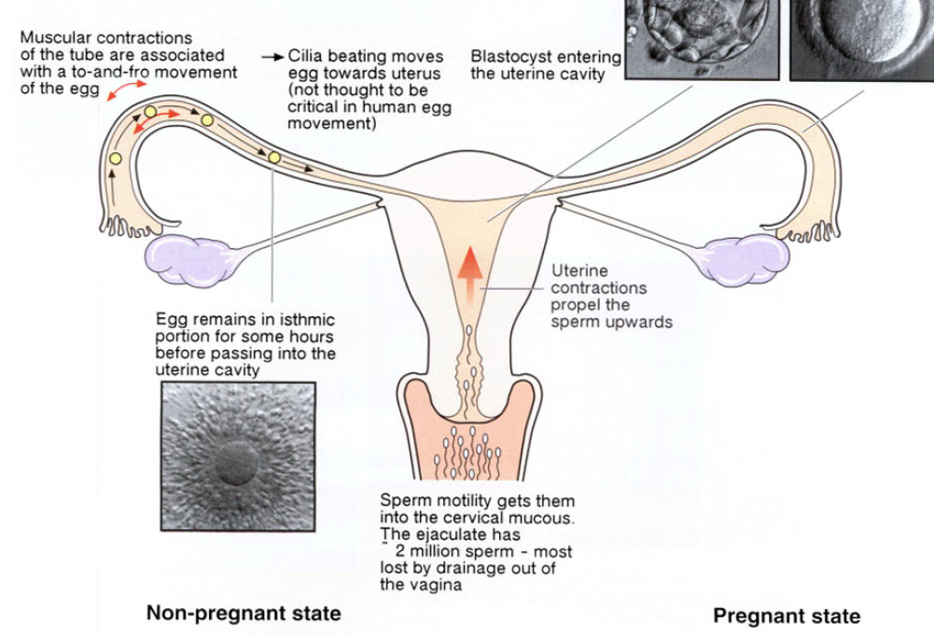

Slide 12
Etiologies
Male Factor 40%
Tubal Factor 40%
Ovulation Problem 10%
Unexplained 10%

Slide 13
Male factors
inadequate or abnormal production of sperm
  • congenital (hypospadias, undescended testis)
  • physical injury (trauma, heat, radiation)
  • varicocele (usually left sided due to anatomy)
  • infection (usually mumps or TB orchitis)
  • smoking, stress, alcohol
  • malignant disease
  • systemic/metabolic disease (endocrine, malnutrition, renal failure, cirrhosis)
❏ sperm delivery problems
  • bilateral obstruction of epididymis or ducts
  • ejaculatory dysfunction, e.g. retrograde ejaculation
  • erectile dysfunction
  • abnormal position of urethral orifice

Slide 14
Male causes
Congenital, for example, hypospadias (ventral external urethra meatus) where the opening is congenitally malformed. Undescended testes, where the testes either remain in the abdominal or inguinal canal or are retractile, that is, tend to go back in the abdomen. Take note that the temperature of scrotal contents is about 1° Centigrade below the normal body temperature. Spermatogenesis is impaired if the temperature of the testes is raised and this is often the case with undescended testes. The temperature can also be raised by frequent hot baths, the use of thick, tight underclothes as well as living at high altitudes for too long.

Slide 15
investigations
In the male partner the following should be done.
  Take a history of sexual function, erection and ejaculation.
  Any past history of orchitis or STDs should be noted.
  It is important to establish how often intercourse takes place, whether there is any experience of difficulty in either partners, discomfort or lack of satisfaction (the male orgasm which brings about ejaculation of the semen is essential for fertilisation).
A clinical examination should also be done and should include an
  assessment of the size and consistency of the testes and epididymis on each side.
  assess for the presence or absence of varicocele or hernia and
  the size of the prostate.
  semen analysis (This should normally be the first step in an investigation because if there are no sperms present in the semen, it is pointless to investigate the female.)

Slide 16
Male causes
nfections of bacterial origin, for example, gonococcal chlamydia will block the vas deferens after healing with scarring. Viral infection, especially mumps, can cause orchitis, interfering with spermatogenesis. Therefore, a male child suffering from mumps should be observed keenly for
this complication. Auto-immune problems whereby the cervix can be hostile to the sperm of a man and produce antibodies. Impotence where there is no erection for unknown reasons. Ignorance of coitus and in some cases excessive coitus. Less sperm count (oligospermia ) or no sperms at
all (azoospermia). Endocrine disorders, for example, pituitary failure, adrenal hyperplasia or thyroid deficiency.

Slide 17
Male Factor Infertility
Evaluation:
Repeat semen analysis
Physical exam- varicocele, testicular size
Lab testing- testosterone, FSH, LH
Genetics for special cases
IUI (intrauterine insemination)
ICSI (intracytoplasmic sperm injection)
Donor sperm

Slide 18
Sperm Count
Fresh sample (to lab within 30 mins.) –most sperm in initial ejaculate
Male should be abstinent for 48 to 72 hours

Slide 19
Sperm Analysis
Volume - : 2.0ml or more
pH : 7.2- 8.0
sperm concentration : 20 x 10⁶ spermatozoa/ml
or more
total sperm count : 40 x 10 spermatozoa
per ejaculate or more
motility : 50% or more with forward
progression
Morphology : 30% or more with normal forms
Vitality : 75% or more live, ie. Excluding dye
Bacteriology : (pus cells)

Slide 20
investigations
If the serum contains sperm antibodies, the spermatozoa become immobilised when they come into contact with the cervical mucus. The test should be done three times. Once the seminal fluid analysis has been done and found to be normal, then the next step is to test for ovulation and tubal patency in the female.

Slide 21
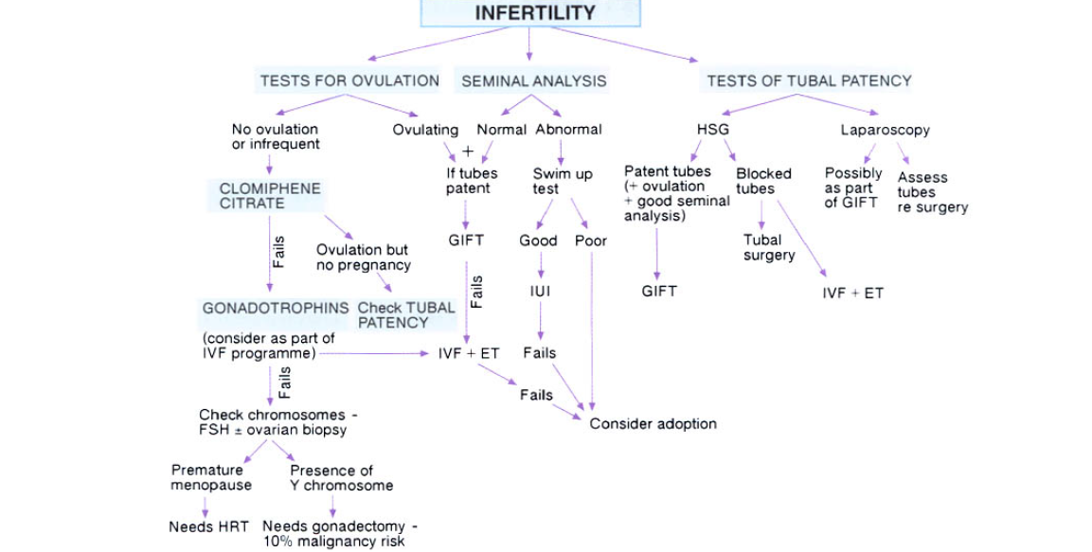

Slide 22
female

Slide 23
Female causes
Congenital, also known as Mullerian agenesis, where there is no uterus or ovaries. Another factor is vaginal atresia, which is the narrowing or stenosis of the vagina.
Infections leading to tubal blockage, for example, sexually transmitted infections (gonococcal, chlamydia), tuberculosis, salmonella, enterobias vermicularis and postabortal or puerperal sepsis.
Endocrine due to pituitary adenoma with increased prolactin leading to inappropriate galactorrhoea which is associated with amenorrhoea and anovulation. Hormonal imbalance with increased oestrogen will lead to endometrial hyperplasia hence irregular period (metropathia haemorrhagica) or prolonged periods and cycles. Hypothyroidism is generally associated with infertility.

Slide 24
Female causes
Diabetes mellitus, if uncontrolled or in those with severe complications may impair fertility.
Uterine fibromyoma, especially if it is large enough to distort the uterine cavity or block interstitial parts of the tube, may also cause recurrent abortion.
Cervical hostility, whereby the cervical mucus is unreceptive to spermatozoa and either prevents their progressive advance or actually kills them. It may be due to infection or the presence of sperm antibodies.
Cervical incompetence is almost always a cause of
mid-trimester abortion and will lead to secondary infertility.
Endometriosis because of the menorrhagia may lead
to infertility.

Slide 25
Etiologies
Male Factor 40%
Tubal Factor 40%
Ovulation Problem 10%
Unexplained 10%

Slide 26
investigations
History
  Any illness which might have caused peritonitis, for example, tuberculosis. This could mean the tubes were also affected.
  Menstrual history, for instance, whether menstruation is scanty or irregular.
  Any abortion or sicknesses should be noted.
  Outcomes of previous pregnancies should also be noted.
  Marital history, including duration of marriage and how long she has been trying to become pregnant.

Slide 27
investigations
Hysterosalpingography (HSG), which remains a useful investigation for tubal patency
A laparoscopy plus dye test does not only allow assessment of tubal patency but also gives proof that the tube is normal in appearance, the fimbriae are healthy and that the tubal movement is adequate.

Slide 28
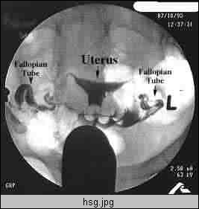
Hysterosalpingogram

Slide 29
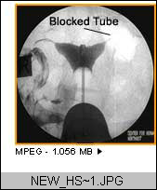
HSG: Unilateral Blocked Tube

Slide 30
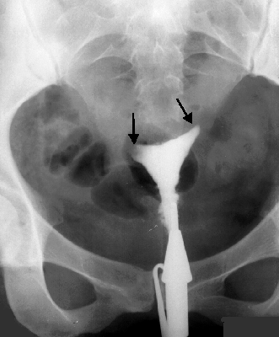
HSG: Tubal Infertility

Slide 31
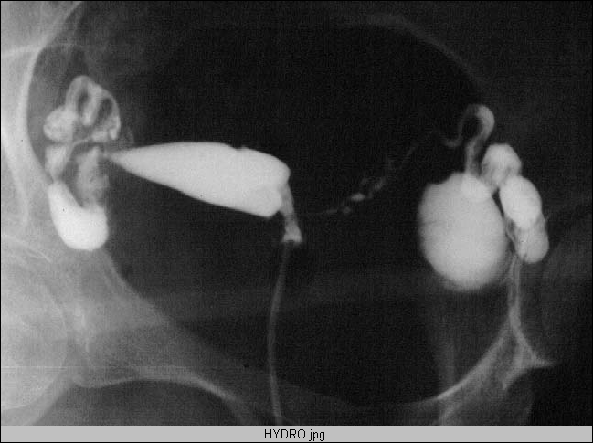
HSG: Hydrosalpinx

Slide 32
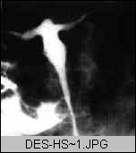
HSG of DES daughter

Slide 33
Etiologies
Male Factor 40%
Tubal Factor 40%
Ovulation Problem 10%
Unexplained 10%

Slide 34
investigations
Ovulation may be confirmed in several ways,
the temperature method,
the examination of cervical mucous,
progesterone level on blood sample taken one week before a period is expected (day 21 of 28 day cycle) and a level of more than 20 mmol/L, which confirms that ovulation has taken place.
ultrasound may detect follicular growth and ovulation
A histological examination of the endometrium should also be performed just before menstruation in order to assess the response to progesterone secretion by corpus luteum and to exclude tuberculosis.

Slide 35
Approach to Ovulation Disorders
Evaluate- Hypothyroidism Prolactin Disorder Hyperandrogenism- PCOS Weight loss/ weight gain
Induce Ovulation Clomid (clomiphene citrate)

Slide 36
management

Slide 37
Clomiphene Citrate
Antiestrogenic effect on hypothalamus
Increase in GnRh
Increase in LH & FSH
Development of follicles
Increase in E2
Increase in LH
OVULATION

Slide 38
ovulation
Bromocriptine
This is effective as an ovulatory agent in most patients with hyperprolactinaemia
It acts by suppressing the central and peripheral concentrations of prolactin, so that its level stimulates the production of oestrogen and progesterone. The dosage initially is 2.5mg up to four weeks.

Slide 39
Human Menopausal Gonadotrophin (HMG) and
Human Chorionic Gonadotrophin (HCG) Pergonal
This is a preparation of leutinising hormone and follicle stimulating hormone extracted from human menopausal urine and is available in ratio of 1:1.
The therapy is indicated when there is failure to ovulate even after clomid administration for six to twelve months. The dosage is HMG 375 units daily, increasing progressively up to 1500 units daily

Slide 40
Tubal patency
Tubal blockage can be treated by salpingolysis, which is the most successful tubal operation and consists of dividing peritubal adhesions around the ampullary ends of the tube.
Salpingotomy involves making an opening into the distal end of a hydrosalpinx and is usually better for fimbrial blockage.
In tubal anastomosis, blockage at the isthmic portion is excised and the cut ends anastomosed.

Slide 41
Intrauterine insemination
Invitro fertilisation
During in vitro fertilisation, the oocytes from the mature ovarian follicle are retrieved, fertilised with the partner's sperm and the developing embryo is replaced into the woman's uterus.

Slide 42
Semen problems, such as azoospermia, secondary to lack of gonadotrophic stimulation, are curable by the administration of Human Menopausal Gonadotrophin (HMG). However, there is no treatment for azoospermia due to congenital anomalies or chromosomal abnormalities.

Slide 43
Oligospermia will often respond to an improvement in the patient's general health and fitness, therefore, exercise and a good diet should be encouraged. The patient should also be advised to avoid excessive consumption of alcohol, tobacco and caffeine.
the excision of varicocele
Undescended testis??

Slide 44
Artificial insemination
IUI (intrauterine insemination)
ICSI (intracytoplasmic sperm injection)
Donor sperm

Slide 45
Other options
Surrogate mothers
Adoption

